Slide 1
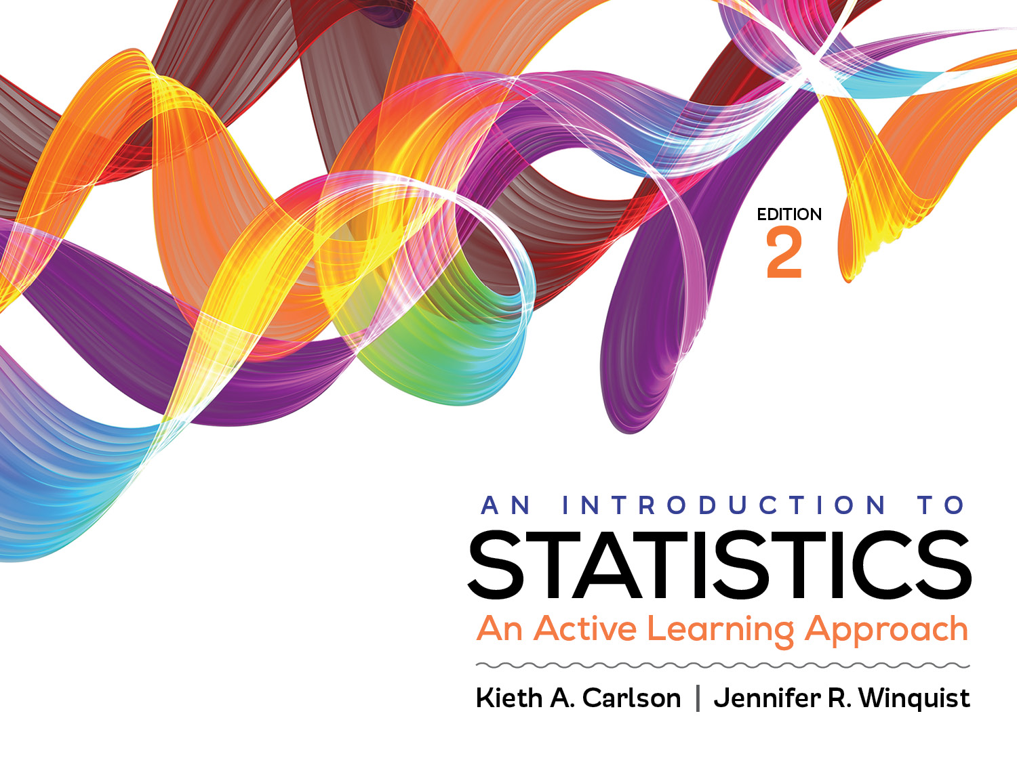
Introduction to Activity 11.3
Independent ANOVA with SPSS

Slide 2
Activity 11.3 will require you to:
Describe within- and between-group variance within the context of an independent ANOVA
Identify things that increase and decrease each type of variance
Explain how high and low within- and between-group variance influences the F ratio

Slide 3
Use the following if you need guidance
For annotated SPSS output go to pages 386–387.
For an example APA-style summary see question 40 in Activity 11.1

